Slide 1
Multiplication Review

Slide 2
Multiplication Property to remember!
When you think about it,
if I have NO sets (or none) of 8,
I have NOTHING (zero).
Just as if I have 8 sets of zero…. I have zero!
0+0+0+0+0+0+0+0=ZERO

Slide 3
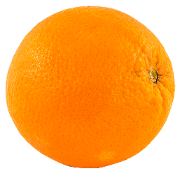
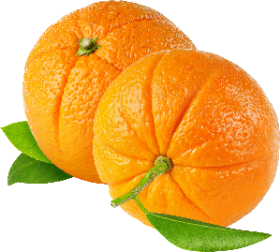
Identity Property: One times any number, is that number!
A row
1 x 8 (1 set of 8)
(1 row of 8)
8x1 (8 sets of 1)
(8 rows of 1)
row

Slide 4
Multiplication Review
Remember, MULTIPLICATION is simply a faster way to add the same number a certain amount of TIMES!
That’s why we say “TIMES”:
as in:
4x2= 4 times 2 (2+2+2+2)
or 2x4= 2 times 4 (4+4)!

Slide 5
How Can We Read Multiplication Problems?
When I see 2 X 4,
I can think “2 SETS of 4” or “4 twice”
Sets (rows)

Slide 6
How Can We Read Multiplication Problems:
When I see 2 X 4,
I can think “2 SETS of 4” or “4 twice”
4
+4
4
Sets (rows)
4

Slide 7
Array: the visual image of a multiplication problem.
1st Row (set of)
1 2 3 4
2nd Row (set of)
1 2 3 4
3rd Row (set of)
1 2 3 4
4th Row (set of)
1 2 3 4
5th Row (set of)
1 2 3 4

Slide 8
Array: the visual image of a multiplication problem.
I SEE
5 rows
4 in each!
5 sets of 4
5 x 4=20
1st Row (set of)
1 2 3 4
2nd Row (set of)
1 2 3 4
3rd Row (set of)
1 2 3 4
4th Row (set of)
1 2 3 4
5th Row (set of)
1 2 3 4

Slide 9
Array: the visual image of a multiplication problem.
I SEE
4 rows
5 in each!
4 sets of 5
4 x 5=20
1st Row (set of)
1 2 3 4 5
2nd Row (set of)
1 2 3 4 5
3rd Row (set of)
1 2 3 4 5
4th Row (set of)
1 2 3 4 5

Slide 10
WOW! I think Ms. White is showing me a few ways I can always be right about my multiplication answers!

Slide 11
I can use or draw an array!
I can write numbers on an array if I was shown one!

Slide 12
I can draw a set!
I can remember my math multiplication facts (1-5)!
3 x 6=3sets of 6
6
6
6

Slide 13
For facts (6-9), I can just use ones I know and add their products!
8x7=(4x7) +(4x7)
8=4+4

Slide 14
The same can be said about every multiplication problem. Think “sets of” when you see a multiplication symbol.

Slide 15
What do you see here? It’s like an array, but it is a set, or group.
What equation would you write for this?

Slide 16
I see 4 sacks with 3 in each. 4 sets of 3 4 x 3 is the correct answer!
Check
your understanding!

Slide 17
Great Thinking!

